Slide 1
THE SELF-EVIDENT TRUTH
FINDING GOD
THRU REASON
Countering New Atheists’ Narratives
Prepared & Delivered By:
Hafidh Saif Al-Rawahy, 2020
Notes:
Type your notes

Slide 2
Why this Topic?
Muslim youths in the West and in the Muslim world are turning towards atheism; Alhamdulillah so far, it’s not a massive movement of Muslims becoming atheists, but certainly it should be an issue of our concern because it’s affecting some Muslim families and Muslim communities
The new atheists’ narratives that are claimed to be hinged on science, but also linked to Western liberalism, are affecting among educated Muslims by creating doubts (Shubuhat) about Islam and Islamic values; Post 9/11 attacks, these new atheists found a fresh target for their criticism on religion – ISLAM & MUSLIMS – the last fortress of sacredness and devotional life
We should be very much concerned about the impact of their ideas and narratives on Muslim youths, because they will affect moral resolve of the individuals and the communities at large – doubts (Shubuhat) cause loss of certainty (Yaqeen) in the teachings of Islam, but also in the commitment (Thibat) of their devotional life
New atheists also impact Da’wah; Their arguments against God, religion, and against Islam in particular are in the air, which is a barrier for those who consider Islam
Richard Sam Daniel Christopher Dawkins Harris Dennet Hitchens
We need to counter atheists’ ideas and narratives especially those coming from the new atheist celebrities who promote atheism as if it is a universal idea - that is common sensical, natural, rational, and represents a default state of mind that all humans can accept, only if they reflect
Notes:
Type your notes

Slide 3
Education & Information
We need to fight that lack of confidence and fear of addressing the new atheism through education and information
We need to realize that atheism is not something that deserve our respect as an intellectual enterprise; Their narratives are not reasonable and can be countered
We plan to deliver a series of talks on atheism under the title
FINDING GOD THROUGH REASON: Countering New Atheists’ Narratives
The talks will provide a broad treatment of the subject of atheism covering its development and adoption in the West as well as its propagation to the rest of the World with the aim to have a better understanding of how its core ideas came about; We hope this will help us to respond correctly to the new atheism
But there is a confidence issue among Muslims even with those involved in Da’awah when it comes to address atheism; There is always a kind of hesitation or fear in dealing with atheism, mainly because new atheists have projected themselves as the brightest intellectuals
Notes:
Type your notes

Slide 4
SUMMARY OF HISTORICAL DEVELOPMENT OF ATHEISM IN THE WEST
16TH CENTURY
17TH CENTURY
18TH & 19TH CENTURY
20TH CENTURY
21ST CENTURY
BIRTH PANGS
OF ATHEISM
BIRTH OF
ATHEISM
MATURATION
OF ATHEISM
DEATH OF ATHEISM
RESUSCITATING DEAD BODY
DOUBTS, SKEPTICISM, BREAK-AWAY FROM TRADITION AND CHURCH AUTHORITY; ALL THIS WITHIN THE SHADOW OF REFORMATION MOVEMENT
DESACRALIZED (SHIRK) THEORIES BY CHRISTIAN THINKERS ON EPISTEMOLOGY, ONTOLOGY, AND MORALITY THAT WERE MEANT TO RESTORE CONFIDENCE IN RELIGION, BUT CREATED A NEW SECULAR BASE THAT UNDERMINED IT
WITH SCIENTISM, DARWINISM & SCIENCE OF COSMOLOGY TO EXPLAIN THE UNIVERSE AND LIFE, ATHEISTIC MODERNITY PARADIGM MATURED; THERE WAS NO NEED FOR GOD & RELIGION; NOW OPEN ATTACKS & BASHING ON RELIGIONS BEGAN
FAILED PROMISE OF UTOPIA BY ATHEISTIC MODERNITY PARADIGMS; WORLD WARS; WMD; GENOCIDES; NAZISM & FASCISM; PERPETUAL MILITARY CONFLICTS; ENVIRONMENTAL DISASTERS; TURNED TO POSTMODERNITY AND NIHILISTIC DISILLUSION
“NEW ATHEISM” IS POORLY REHASHING OF OLD ATHEISTIC IDEAS & REFUTED ARGUMENTS; IT IGNORES PAST FAILURES; PLUNGED INTO MILITANT, CRAZY BIGOTRY, ARROGANCE, AND ISLAMOPHOBIA
Notes:
Type your notes

Slide 5
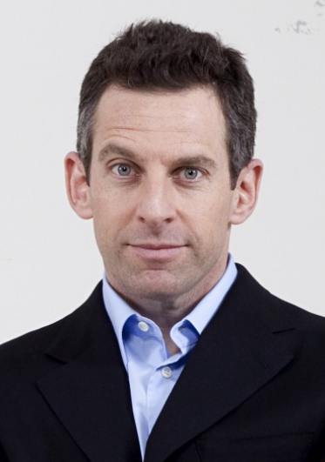
NEW ATHEISM
Based on a naturalist worldview - the physical world is all there is, rejecting all kind of “unseen”; Science is the the only means of understanding reality
Projecting intellectualism and use of reason
Morals and ethics are not from God or religion; Science can explain everything
Faith is just a hypothesis (as making truth claims), must be empirically tested and be rejected on the grounds of insufficient evidence
Religion is wrong, irrational, not needed, and should be banned; Islam is violent and dangerous; Must be defeated at any cost
Societies should stop teaching children religion, because it fosters prejudice and violence
Support military interventions to defeat religion when civilized world is under threat
New Atheism is a term coined to describe the position pushed by the 21st century atheists crowned by Sam Harris’ 2004 book is response to 9/11 attacks, “The End of Faith: Religion, Terror, & the Future Reason”
Notes:
Type your notes

Slide 6
AGENDA
Finding God Through Reason:
Countering New Atheists’ Narratives
1
2
3
4
5
The Foundational Belief
Islamic Concept of Fitrah
The Existence of God
The Oneness of God
The Attributes of God
Part One
Part Two
Part Three
www.iicoman.om
Notes:
Type your notes

Slide 7
What is Atheism?
Theist (from “theos” in Greek) is someone who believes in a God or gods; Atheist is someone who “is NOT a theist”, meaning who does not believe in a God or gods
There are three scenarios of an atheist’s disbelief :
Does it mean: the one who describes himself or herself as an atheist, has arguments in favor of atheism?
Does it mean: the one who describes himself or herself as an atheist doesn’t have argument in favor of atheism, but is currently not convinced by any of the theistic arguments?
Does it mean: the one who describes himself or herself as an atheist, is saying that just because made a conscious choice not to believe in any god?
The 1st position makes a knowledge claim, therefore, must provide evidence; The 2nd position is more of agnostic, and there is a strong hope if presented with good argument(s); The 3rd position has irrational “blind” faith in atheism, and there is little hope, but discussion can focus on purpose of life and importance of religion
Theism (belief in God) is a rational & natural position; Atheism (not belief in God) is irrational & unnatural position
In the same way it’s rational & natural to believe in the reality of the past or to believe in the law causality or to believe that other people have minds
If you reject any of these propositions you are both irrational & unnatural; Unnatural because that kind of cognitive position must be acquired, it doesn’t come naturally; If you reject the reality of the past as an illusion in the mind, it is irrational & unnatural
Refer to many scientific studies from different disciplines on “Why belief in God is natural?” such as the work of Olivera Petrovich, Paul Bloom, Justin Barrett and Deborah Klemen
Notes:
Type your notes

Slide 8
Islamic Understanding of Atheism
The traditional Islamic term for atheism is “Ilhad”, which literally means “deviation”; It implies that atheism is a deviation of what is natural or atheism is unnatural
This is in line with the Qur’anic and Prophetic teachings of “Fitrah” (that all human beings are born with an innate nature or state that acknowledges God and has affinity to worship Him); Therefore, theism is natural and atheism is unnatural (an aberration of the human psyche)
The Islamic doctrine of Tawhid (the Oneness of God) considers any opposite of Tawhid as Shirk, therefore, from Islamic point view, atheism is also a form of Shirk
It is not surprising that the Qur’an even though speaks about “Ilhad” specifically in few places, but focuses much more on Shirk; Shirk is seen in the Qur’an as the major problem that drives humanity against submission to the will of God and against leading devotional life
The Qur’an asserts that those who reject a Creator “are not certain” and describes those who reject Monotheism as “fools”, which implies that polytheists and by extension atheists are irrational and unwise
Therefore, the Islamic description of atheism: It is an unnatural worldview based on uncertainty and irrationality; This definition of atheism is not neutral, because it assumes the existence of God - a Creator
The Qur’an, thus, does not accept atheism to be the default position; The default position is theism
Shirk as an antithesis of Tawhid, can be committed in four areas: (1) Shirk of Divinity (Uluhiyyah); (2) Shirk of Lordship (Rububiyyah); (3) Shirk of Worship (Ubudiyyah); (4) Shirk of Attributes (Asmaa wa Sifaat)
Atheists commits all the four Shirk; More obvious Shirk of Lordship & Attributes by accrediting the origin of the universe and origin of life to other than God, and denying Him as the Creator & Sustainer of the universe
Notes:
Type your notes

Slide 9
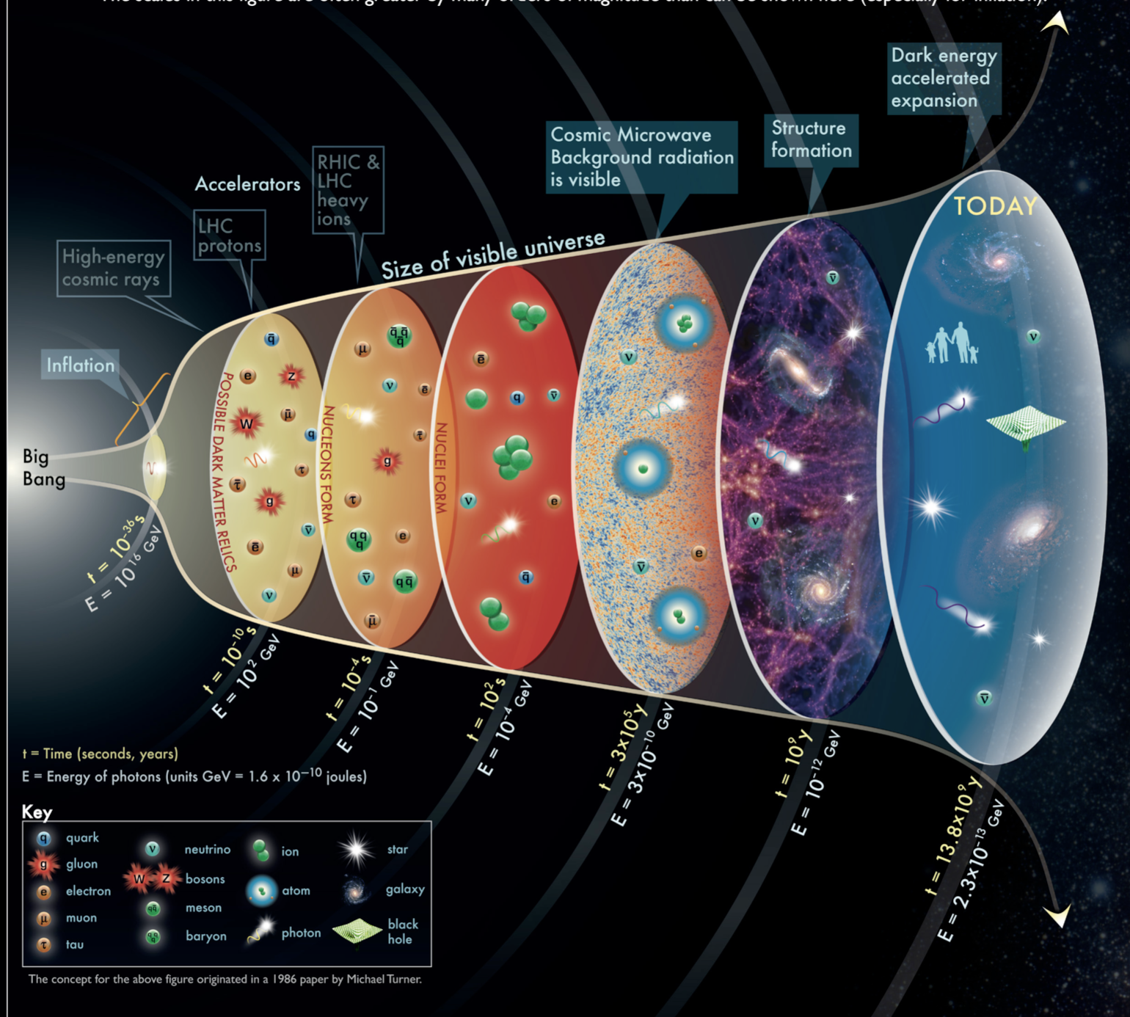
Atheism From Islamic Framework
As a Muslim, the best way to approach atheism is to frame it in the Islamic frame of reference
In the Islamic frame of reference, we have TAWHID and we have SHIRK, which is opposite to Tawhid
Tawhid is unique to Islam and it is what distinguishes Islam from all other religions, systems of belief, creeds, theologies, philosophies and ideologies – which all carry some form of Shirk, in one way or another
What atheists present to public as a common framing is the Singularity of Atheism vs Multiplicity of Religions
With the Islamic frame of reference, which is the correct framing, we have the Singularity of Tawhid (Islam) vs Multiplicity of Shirk (False Religions, including Atheism)
The two facets of atheistic thought that are obviously contradictory to Islam would be related to:
Where does the universe come from?
What determine change in the universe through time?
With Islamic Tawhid, it is very clear about where does the universe come from and what determine change in the universe through time
Allah is the Creator and Sustainer of the universe and everything in it; He is also the sole Law-Giver of all the natural laws that govern the universe; Those who contradict this reality commit Shirk
Notes:
Type your notes

Slide 10
THERE ARE MANY WAYS TO DISBELIEVE AS THERE ARE TO BELIEVE,
BUT THERE IS ONLY ONE CORRECT CREED – TAWHID (ISLAM)
Atheists claim that atheism is TRUE and theism is FALSE, because of the SINGULARITY of atheism as opposed to the MULTIPLICITY of theism
That’s why atheism is promoted as a universal idea that is simple, common sensical, natural, rational, default state of mind that all humans can easily accept, as opposed to many beliefs in theism with different religions, creeds, gods, acts of worships, sacred laws, histories, prophets, etc.
The truth is, atheism is a big umbrella with many shades, grades and categories of disbeliefs
Atheists also differ in knowledge, affirmation, scope, openness, religiosity, action, friendliness
Therefore, the Islamic frame of reference: Singularity of Tawhid (Islam) vs Multiplicity of Shirk (False Religions, including Atheism) exposes and removes this false presumption of atheism
Antitheists
Agnostics
Humanists
Freethinkers
Accommodationists
Religious
Atheists
Deists &
Pantheists
Unaffiliated
Atheists
Notes:
Type your notes

Slide 11
The Default Question
Many times when dealing with atheists, we have allowed ourselves to be put on the defensive position by entertaining their usual first question: “Does God exist?” or “What proof do you have for God’s existence?”
And we usually respond by presenting all the positive argument(s) for God’s existence that we have, and Muslims do have MANY different kind of good arguments that support a belief in God
Because atheists, possess NO valid argument(s) against existence of God, then the natural default position must be the belief in God; The atheists’ position of rejecting existence of God is UNNATURAL
Therefore, we should not let atheists’ question of “Does God exist?” or “What proof do you have for God’s existence?” become the DEFAULT question
Instead, we should first probe into atheists’ position by asking them the correct DEFAULT question: “What evidence do you have to reject God’s existence?”
We describe many beliefs that self-evidently true that are natural or true by default
If someone questions their truth, we usually do not blindly accept their argument, but probe him or her with a question, “What evidence do you have to reject them?”
Existence of God is one such belief that is self-evident true that can be described as natural or true by default
Therefore, theist’s position is the default position and atheist’s position must be probed with the question, “What evidence (or reason) he or she has to reject existence of God?”
Notes:
Type your notes

Slide 12
Main Characteristics of Foundational Belief
A foundational belief is characterized by the following five universal principles:
UNIVERSAL - It is not a product of specific culture or social condition
UNTAUGHT - It is not based on external information transfer
NATURAL - It is formed due to natural functioning of the human psyche
INTUITIVE - It is easiest and simplest interpretation of the world
INCORRIGIBLE - It cannot be disproved or annulled
A good starting point for our journey, therefore, is to define a “foundational belief”, which is a belief or a conviction that we have in our hearts and minds as true and natural, simply because it is a self-evident truth that requires no proof
Notes:
Type your notes

Slide 13
The Foundational Belief
Faith in the existence of God is the foundational belief - the self-evident truth, which is natural and requires no proof; The Qur’an says, “…Can there be doubt about God, Creator of the Heavens and Earth?...” (Qur’an 14:10)
There are many examples of foundational beliefs that we are all taking for granted in our hearts and minds, including atheists and scientists:
The reality of the external world
The uniformity of nature
The intelligibility of nature
The law of causality
The validity of reasoning
Truth is worth seeking
In the same way, belief in the existence of God - a transcendental Creator and Sustainer of this universe, is self-evident truth, which is natural and requires no proof
Notes:
Type your notes

Slide 14
Any explanation of the reality of the universe and life that does not recognize existence of the one living God - the Creator and Sustainer of the universe, who is described by all perfections and possesses infinite power, will, and knowledge is flawed in its foundation
Therefore, the new atheists’ worldview which is built on the premises that:
God does not exist
Nothing is beyond the physical material world
The only way to arrive to reality, knowledge and truth is through empirical science
Is flawed, misguiding, unnatural, irrational & not default state of the mind
Belief in the existence of God is not only foundational, but it is necessary for human beings to make sense of the universe, life in this world, the nature around us, our consciousness and rational mind, the anchor for our morals and ethics
Notes:
Type your notes

Slide 15
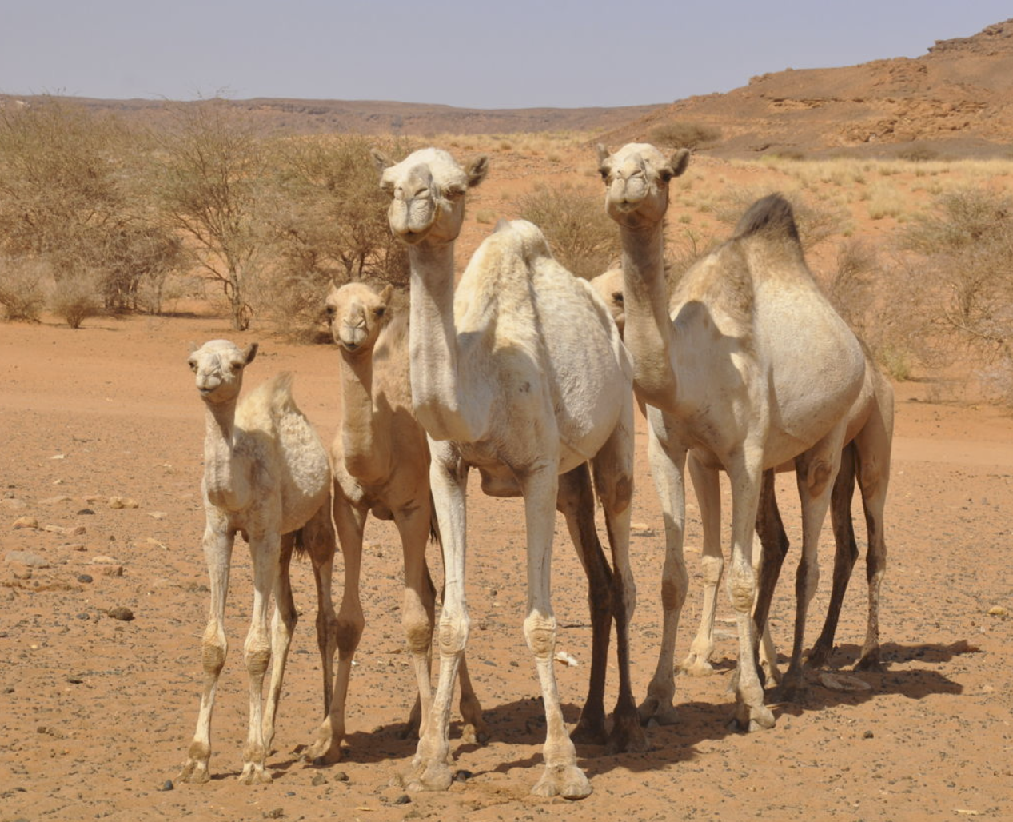
Positive & Negative Proof
Those who follow atheistic worldview or mindset that denies existence of God, not only have difficulty to explain about the origin of the universe and all creations in it, but also about the origin of human life, its meaning, its value, and its purpose
To prove something existing requires a positive proof by simply pointing to the sign of its existence or presence, which is easy, but to prove something non-existing requires a negative proof by exhaustively searching for its non-existence or absence, which is very difficult
The Qur’an teaches us to ponder on positive proofs for existence of God: “Then do they not look at the camels - how they are created? And at the sky - how it is raised? And at the mountains - how they are erected? And at the earth - how it is spread out? [Qur’an 88:17-20]
Therefore, atheists would need to produce negative proof(s) for their denial of existence of God; Because it is a difficult task, if not impossible, to produce such proof(s) against the existence of God, they have been hiding behind scientism and liberalism
“Soon we will show them our signs in the horizons and in themselves until becomes clear to them that it is the truth is it not sufficient concerning your Lord that He is, over all things, a Witness” [Qur’an 41:53]
Notes:
Type your notes

Slide 16
What is the Source of Knowledge?
If faith in God requires ”independent” scientific confirmation, what about the gigantic faith these new atheists place on science itself?
What is the “independent” confirmation that could provide evidence for this flawed epistemology: “That all true knowledge only comes from scientific enquiry?”
If the new atheists cannot accept the knowledge that came from divine revelation, “What about the many other channels through which we daily come to know, experience, understand, and the world?”
For example, the evidence of love between two persons cannot be measured or objectively proved by science, even though love itself is real
New atheist intellectuals argue that in order to accept the idea of God to be true, there must be a way of confirming the reality of God through science independent of faith, because all true knowledge only comes from scientific enquiry
Notes:
Type your notes

Slide 17
Experiencing God
The only way any one can encounter the subjective depth of another person’s feelings (happiness or sadness, love or hate, fear or calmness, anger or humor) is to abandon the objective method of natural science
In fact, to treat the subjectivity of another person as though it is just another object in nature is both morally and ethically wrong; Therefore, to encounter with another person’s subjective depth, it challenges one to put aside the objectifying method of natural science and enjoy interpersonal experience
Likewise, to have an encounter with a great work of art or with the beauty in nature, one will miss the aesthetic “evidence” completely, unless one abandon the objectivity of science and allow oneself to be captivated by it
Therefore, Do the new atheists seriously believe, the “evidence” for existence of personal God of infinite beauty and unbounded love, could be gathered cheaply by a scientific hypothesis?
It is interpersonal experience and logical reason, not the impersonal objectivity of science, would be essential the way to know, understand, and experience God and being present and conscious of Him
Notes:
Type your notes

Slide 18
Is Existence of God a Hypothesis?
The strategy of new atheists is to seduce their audience into agreeing that belief in the existence of God is a “faith hypothesis” that functions for believers in the same way as a “scientific hypothesis” does for scientists
A constant catchphrase of the new atheists is as follows:
The fundamental problem with faith is that it is based on “no evidence” or at best on “insufficient evidence,” and therefore must be rejected in all its forms
Science by contrast can point to countless reproducible observations that support its hypotheses
A good scientist is willing to give up or modify his or her “scientific hypothesis” if the experiment requires doing so, but the faithful cling to their “faith hypothesis” no matter how nonexistent the evidence
Science cannot detect or to rule out existence of God, because existence of God is NOT a HYPOTHESIS
When we say science cannot detect the divine, it doesn’t mean that God is out of the mind’s and heart’s range
At a usually tacit level of awareness, both the atheists and the theists participate in a common faith – they all believe that the reality is intelligible, that the truth is worth seeking, that life has meaning and purpose, and that people should behave moral and ethical
What we defer, theists know as part of their human nature that there exist a God - an infinite Being who possesses Power, Will, Knowledge, Truth, Reality, Meaning, Goodness, and Beauty
New atheists bend to the level of silliness as implied in their caricature understanding of God and religion
Notes:
Type your notes

Slide 19
The Need for Faith
At the foundation of every human search for truth and understanding, including the scientific search that our new atheists friends are bragging about, a deep-rooted element of “trust” is present
If you find yourself doubting this statement, it is only because, at this very moment, you trust your own mind enough to express concern about this assertion; You cannot avoid trusting your mind and its intellectual capacity, even when you are in doubt
Trust is just another word for “faith” in theology, and only a little reflection will convince you that every inquiry of every human endeavor emerges from the murkiness of some sort of faith, without necessarily an objective scientific empirical evidence
Even if you believe that seeking truth is worthwhile, which most of us do, the idea is founded on faith because you cannot prove it and even if you attempt to do so, you already presupposes this faith; Faith launches and energizes every honest human inquiry, not least the scientific inquiry itself
New atheist intellectuals place enormous trust in their own power of reason in their refutation of God and religion
They make tacit act of faith in their own critical intelligence, but without providing us with any good and independent reason as to why they should trust their mind to lead themselves and us to the truth?
They simply believe blindly (a) in the presumed superior capacity of their own mind to find truth, and (b) in the presumed poor capacity of the minds of people whom they think are misguided by religious faith
In order to be a reliable guide for the rest of us, they must trust their mind that they can put us in touch with the reality – SIMPLY BLIND FAITH
Notes:
Type your notes

Slide 20
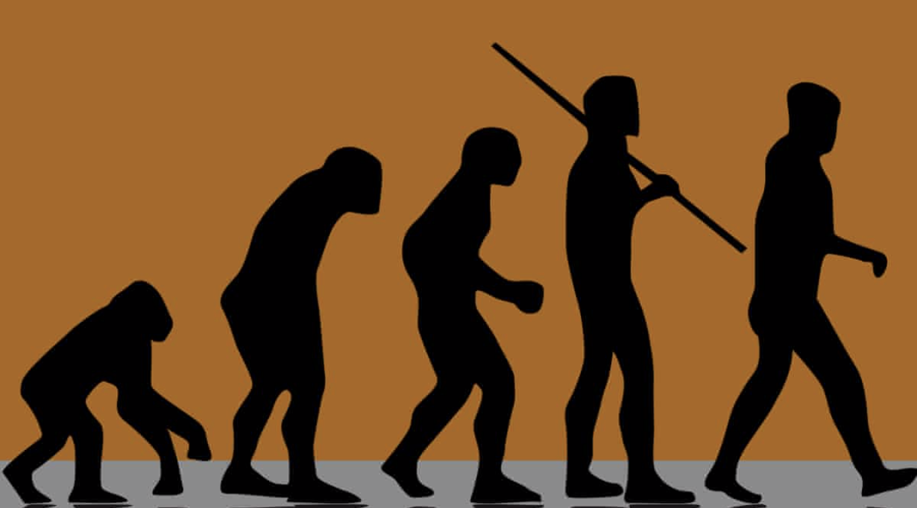
The new atheists’ own belief system, “scientific naturalism,” logically undermines “validity of reason”; If our minds have evolved from a mindless state of nature, why should we trust these same minds to put us in touch with the reality?
In order to justify validity of our reasoning, something must have come outside the scientific naturalism of Darwinian evolution; For if our minds are nothing but the accidental outcome of a mindless and purposeless evolution, Why should we trust our minds at all?
New atheists have failed to explain about human consciousness and human mind by scientific naturalism
Notes:
Type your notes

Slide 21
Does Theology Matter?
One would expect new atheist intellectuals when they write their books and engage in public speaking, they would study or research theologies of the religions they viciously oppose and attack, but aside from few barbed references here and there, there is no sign of any deep understanding of theology
When it comes to Islam, they are totally ignorant and foolish; They describe Islam at its absolute ugliest - what Islam and devoted Muslims consider as the most objectionable practices (such as oppression of women, racism, injustice on others, violence, and extremism) sum up for them as what Islam is really all about
New atheists do not care at all whether theologians read their books or not; They would prefer not, because they are not writing for theologians, but for the masses of uninformed readers to keep them way from religion
New atheism fully relies on and borrows from religious concepts in their discourse, yet they attack and ridicule the very same fountain that they drink from
Non of the writers of new atheism exhibits scholarly expertise in the rich tradition of Islamic studies, theology, exegesis and jurisprudence
In their opposition and rejection of Islam, they do not rely on scholarly reputation or philosophical reason, rather on obnoxious, arrogance, attacks, deceptions, and ridicules
They confuse from the few extremists who misuse religion from the benevolent teachings of the religion itself, not recognizing that the worst of crimes in recent history against humanity were perpetrated by atheists and their paradigms
They accuse Muslims of extremism and intolerance, but they scarcely notice the irony in their own extremist and intolerance behavior
Notes:
Type your notes

Slide 22
The Paradox of Atheistic
Worldview
Without God, the physical universe is all there is, and human beings are just accidental byproduct of mindless and purposeless nature, not intentionally designed or created, but appeared by chance; If no intention, no purpose
If God does not exist, it does not matter what one believes or what choices one makes in life?
Living kind, generous, thoughtful and devotional life or living horrible, violent, selfish, immoral, and hedonistic life would have been the same
Irrespective, our lives would have no objective meaning, value or purpose
If God doesn’t exist, there is no absolute standard of moral value; New atheists have failed to explain the objective basis for their moral value
One can tell the world that he or she is an atheist, but he or she cannot live like one
An atheist may claim to be a disbeliever, but can only live a partial life of a believer – life of meaning, value and purpose
Notes:
Type your notes

Slide 23
SUMMARY
The rise of atheism should be an issue of our concern as it is affecting Muslims youth and Da’wah
Atheism didn’t come out of the blue; It has 400 years of history in Europe; It died in the 20th century and was resuscitated in the 21st century after 9/11
Atheism is unnatural, irrational, and a form of Shirk; The correct framing should be Singularity of Tawhid (Islam) vs Multiplicity of Shirk (False Religions, including Atheism)
Faith in God is the foundational belief; It’s self-evident truth that requires no proof, and therefore, it’s the human’s default state
Atheists’ demand of scientific evidence for God’s existence independent of faith is illogical and contradictory
Their Naturalist worldview, scientism & validity of reason cannot be independently verified
Other channels of knowing have always existed; Faith is needed always even in science
Existence of God is not a hypothesis; Knowing God is thru interpersonal experience & reason
No one can truly live atheistic life, and atheists cannot explain the basis of their moral behavior
Without God, no one can make sense of the universe and life; Life would have no meaning, value or purpose; Wouldn’t matter how you live
Atheists scientific naturalism undermines the validity of reason; How can you trust minds that have long evolved accidently from mindless and purposeless matter
Atheists cannot explain the real origin of human mind and human consciousness
Notes:
Type your notes

Slide 24
Thank You
Notes:
Type your notes

