Slide 1
THE SELF-EVIDENT TRUTH
FINDING GOD
THRU REASON
Countering New Atheists’ Narratives
Prepared & Delivered By:
Hafidh Saif Al-Rawahy, 2020
Notes:
Type your notes

Slide 2
After 150 years, there is still a dissent within the scientific community on Darwinian theory
At a populous level among new atheists, the theory has been wrongly used to deny God and is promoted as “immutable” and “absolute” truth; Any opposition or skepticism on Darwinian theory brings accusation of being irrational, dogmatic, and unscientific
At a professional level and among renown practicing scientists in various related fields, they consider the theory as a scientific model of the day to explain the complexity of life, but they also recognize it is probabilistic with many assumptions and unresolved disputes
New atheists are being defeated in their denial of God by using reason; They have taken Darwinian theory as their main comfort zone; By misusing science they practice “scientific extremism”, in the same way there are “religious extremists” who misuse religion
Today, Darwinian theory is not challenged on religious grounds only, as much on scientific grounds by the intelligent-design movement
2
Notes:
Type your notes

Slide 3
AGENDA
Finding God Through Reason:
Countering New Atheists’ Narratives
1
2
3
4
5
The Foundational Belief
Islamic Concept of Fitrah
The Existence of God
The Oneness of God
The Attributes of God
Part One
Part Two
Part Three
www.iicoman.om
3
Notes:
Type your notes

Slide 4
Proof for the Oneness of God (Tawhid)
The three possibilities when assuming more than one God:
Each natural phenomenon in the universe is caused by (or an effect of) all the assumed gods
Each natural phenomenon (or a group of natural phenomena) in the universe is caused by (or an effect of) a particular god among the assumed gods
All the natural phenomena in the universe are caused by (or an effect of) one of the assumed gods, and the other gods are acting as administrators of the universe
The idea that there are more than one God who created and sustain the universe can be analyzed through the following three possibilities; Our goal is use our basic reasoning to show that it is IMPOSSIBLE to have any of those three possibilities
4
Notes:
Type your notes

Slide 5
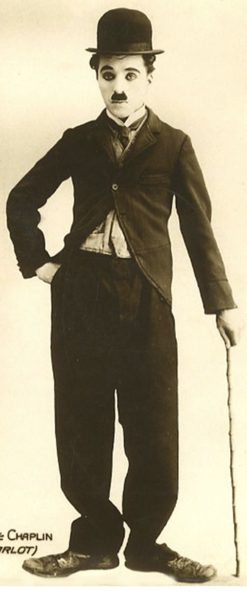
Disproving the First Possibility
The first possibility: Each natural phenomenon in the universe is caused by (or an effect of) all the assumed gods
We have established in the previous talk the complete dependence of an effect to its first cause using an example of imagination of a flower in our minds, which is actualized (created) by the will of our souls; Its existence is sustained in our minds as long as we pay attention to it; It ceases to exist as soon as we shift our attention elsewhere
Therefore, if two or more gods are assumed to create a particular existent, it would imply that each of the assumed gods would externalize a separate occurrence of the same existent, resulting in multiple occurrences (or copies) of the same object, whereas in reality it is not the case, there is only one occurrence of each object
For example, if three gods are assumed to have created an individual e.g. Charlie Chaplin, it would imply that each of the assumed gods would externalize a separate occurrence (or copy) of Charlie Chaplin, resulting in three similar versions of Charlie Chaplin
5
Notes:
Type your notes

Slide 6
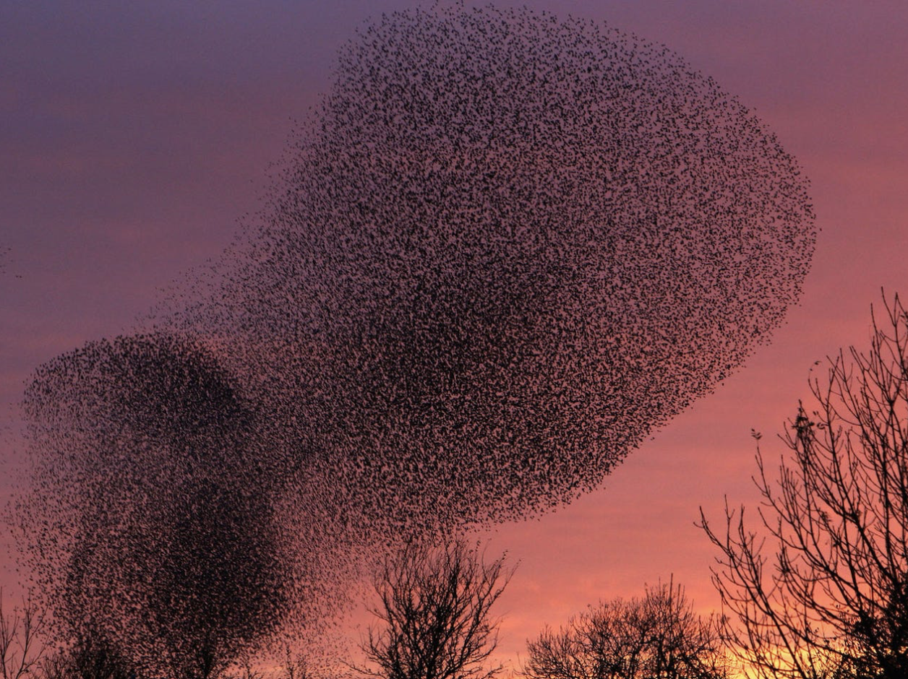
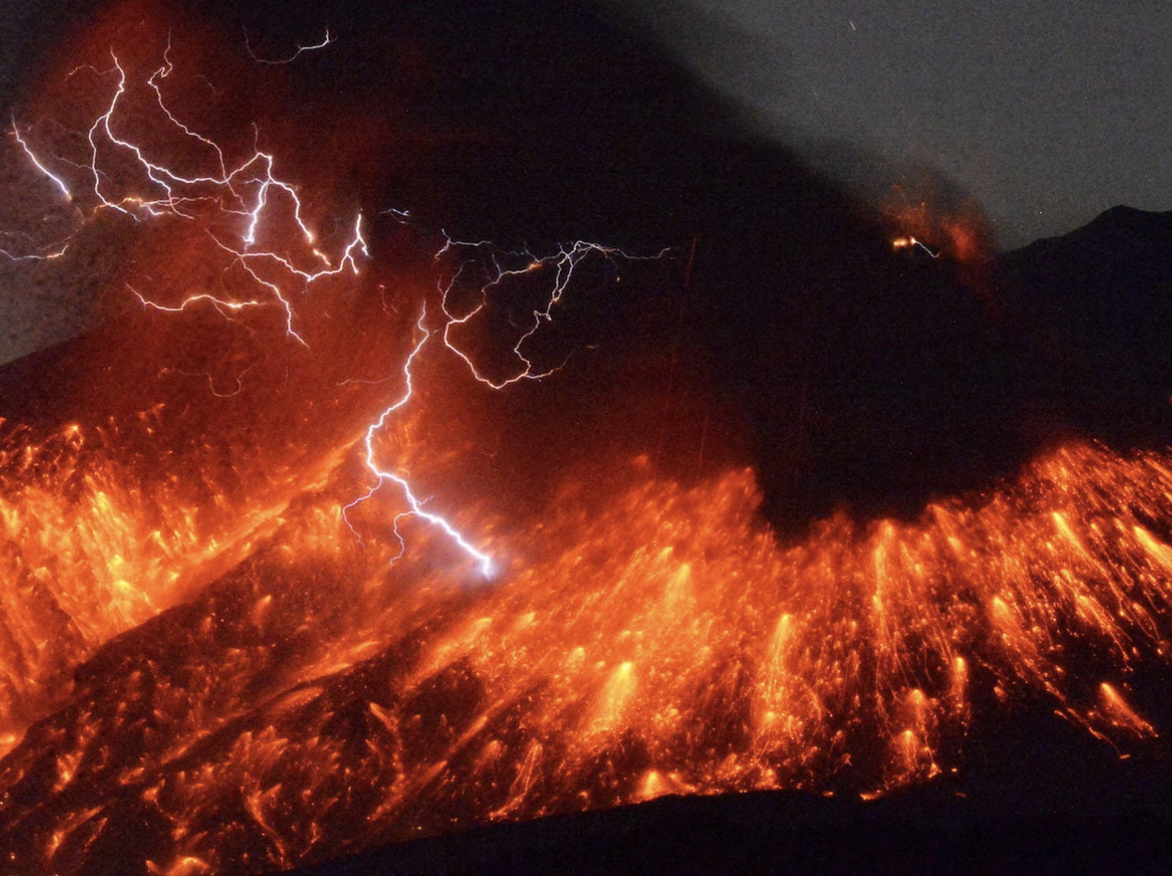
Disproving the Second Possibility
The second possibility: Each natural phenomenon or a group of natural phenomena in the universe is caused by (or an effect of) of a particular god among the assumed gods
The assumption of having more than one god demands a universe that has a HETEROGENEOUS ORDER with natural events or phenomena unconnected, unrelated and independent from each other
In reality, the universe displays a HOMOGENEOUS ORDER such that no event or phenomenon is “unique” and “independent” of other events or phenomena; Everything in the universe is interconnected, interrelated and interdependent; This relationship pervades all the constituting parts of the universe, bringing about a comprehensive and all-encompassing organic unity
Past events are linked to the present events, and present events create grounds for future events; Even events which are coexisting parallel to each other, they still share some connection
6
Notes:
Type your notes

Slide 7
Disproving the Third Possibility
The third possibility: all the natural phenomena in the universe are caused by (or an effect of) of one of the assumed gods, and the other gods are acting as the administrators of the universe
It is not possible to have this kind of arrangement, because CREATION and SUSTENANCE are the same act by the same agent; The one who creates or gives existence (CREATOR) is the same one who sustains that existence (LORD); No independent existent has the means to intervene to an effect, unless if granted authority by the CREATOR/LORD
Therefore, none of the gods who are assumed to have administrative role can be considered as LORD, because the true meaning of a LORD is the one who can freely and independently intervene in the creature’s existence and sustenance
Although the Creator may bestow special powers to His creations as in the case of Prophet Issa (AS) who brought to life dead persons, but his action is not considered as independent intervention, because God sanctioned it
The Oneness of God is not arithmetical so to speak, which means that we can not even talk about another god or two gods or multiple gods, without being ABSURD, not only in theological terms, but also through reason as we truly try to understand the real meaning of the Absolute Being
An example to drive home this non-arithmetical understanding of Tawhid, if you think of the concept of “whiteness” in color – just pure whiteness as such – not whiteness as in white mixed with other sheds or some percentage of white or as in a white car or white paper or white cloth, just pure “whiteness” as such, then there is only ONE and UNIQUE such concept existing
7
Notes:
Type your notes

Slide 8
AGENDA
Finding God Through Reason:
Countering New Atheists’ Narratives
1
2
3
4
5
The Foundational Belief
Islamic Concept of Fitrah
The Existence of God
The Oneness of God
The Attributes of God
Part One
Part Two
Part Three
www.iicoman.om
8
Notes:
Type your notes

Slide 9
God’s Attributes of Essence
The ultimate and perfect form of these ontological perfections and unboundedness must then be within the the first cause, God, that has bestowed existence and perfection to all His creatures
God must have full possession of all perfections that are in creation, but without any bounds or limitations
Since it is not possible that the giver of life is void of it, or the giver of power, knowledge, and wisdom is Himself helpless, ignorant and unwise
The existence of these perfections in the creatures indicates the presence of ontological perfections within the Creator, and without any limitation
It is not sufficient to merely know that God exists, because atheists may conceive of Him as cosmic energy or matter; We need to prove that God has Life, Power, Knowledge, and Wisdom; Since these concepts are also used for describing creatures, it is their ontological perfection and unboundedness that apply to God
9
Notes:
Type your notes

Slide 10
God’s Attributes of Life
The concept of life or living is used for defining two groups of creatures: vegetation, which is characterized by growth, and humans & animals, which is characterized by possession of consciousness & will
The first meaning of life that characterized by growth cannot be associated with God, because it is limited and imperfect, as vegetation requires external factors for development and growth in order to reach perfection, and this pertains to the negational attributes of God as mentioned in our previous argument
The second meaning of life that characterized by consciousness and will (as we indicated in Part Two that through consciousness, freewill and use of faculty of reason human beings existentially pursue perfection and excellence), although it comprises of limitation and defects as applicable in creatures, it could be applicable to God but with the consideration of being perfect and unlimited
Although life is related with living of material creatures, in reality, it's the essential characteristics of non-material entity (spirit/soul) that has been hosted in the material creature
For example, the human body material (which is material) is regarded as living, is due to the effect of the spirit/soul (Ruh/Nafs) i.e. In other words, application of attribute of life to the material existence is accidental
Just as progression or growth is essential for the material existence, life is essential for non-material existence
All of non-material existents have the essential attribute of life; As the essence of God is non-material, therefore, God has Life as His attribute of essence
10
Notes:
Type your notes

Slide 11
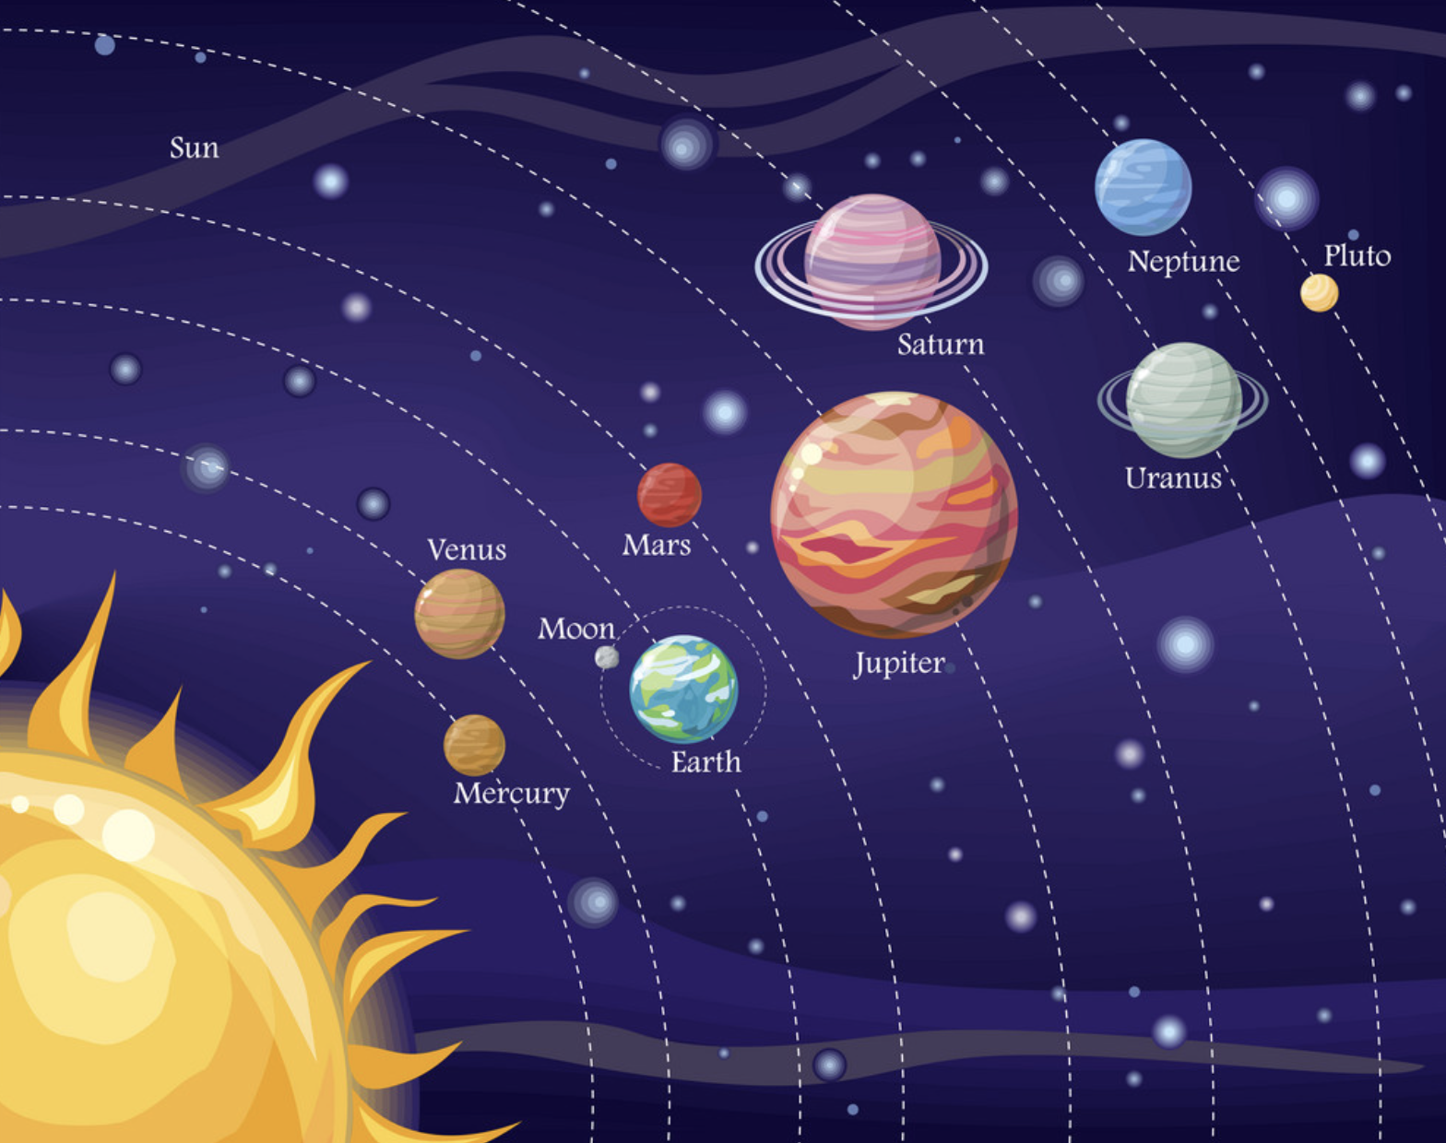
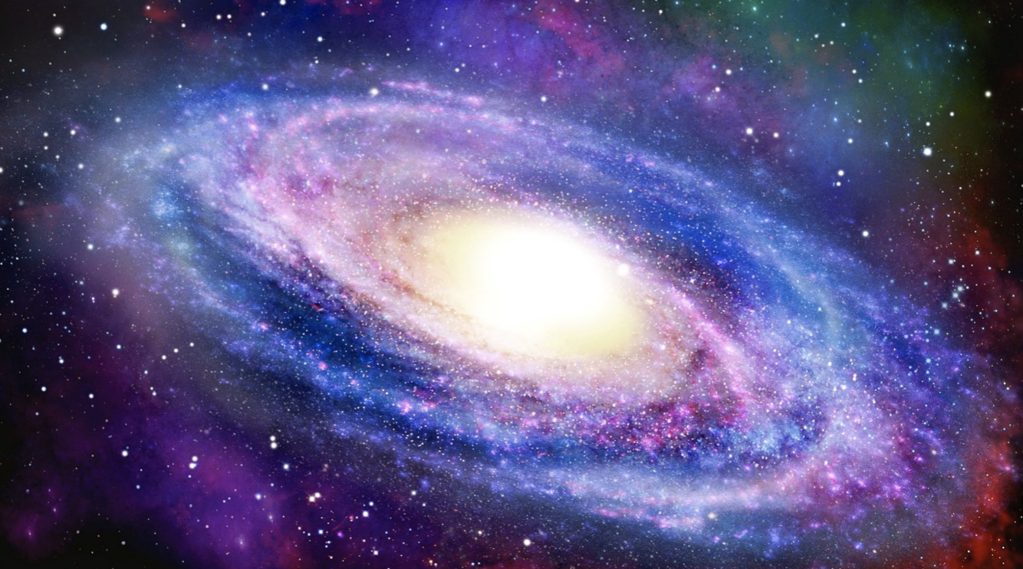
God’s Attributes of Knowledge
There are many ways to prove God’s knowledge; Three ways are cited here:
One way, since knowledge exists within the creature, verily the ultimate perfect form of it and unbounded must exist within the Creator
Second way, God’s knowledge can be proven through the argument of complexity, orderliness, intelligence, perfection, and purposefulness of the universe; The manifestation of this complex, orderly, perfect, intelligent and purposeful universe has clear indication of a precise and perfect knowledgeable Creator; Just like an intellectual book or eloquent poetry or any form of arts is the sign of wisdom, taste and knowledge or qualification of the artist, the universe reflects the perfect and unbounded knowledge of the Creator
Third way is based on speculative philosophy that established the principle that every non-material existence has self-contained knowledge
11
Notes:
Type your notes

Slide 12
God’s Attributes of Power
When an agent produces an action voluntarily with an intention and freewill of its own, it is said to have the Power (or Qudrah) of performing the act
The level of Power (or Qudrah) is dependent upon the level of perfection of an existent; For example, an existent with infinite perfection will have infinite Power
Therefore, God is the possessor of all perfections (already proven in the previous arguments), He must possess infinite Power, meaning He is able to do anything
Atheists sometimes bring to the table tricky and absurd questions related to God’s power e.g. Can God throw you out of His kingdom? Or Can God create another God?
Christians too justify the idea that God incarnated to the world as Jesus on the basis that God can do anything
We say, God’s voluntary action must be possible to actualize (doesn’t defy logic) and God must have the desire to actualize it i.e. A thing that is essentially impossible or necessarily absurd will not have relevance
The Qur’an says: “Indeed Allah has power over all things” (Qur’an 2:7), however, one must be mindful of certain points:
While God possesses the power to perform anything, it doesn’t mean that He will have to perform everything, but whatever God intends to perform, He will perform
God is all-wise, and therefore, He will not perform an act which is unwise
Since power includes the quality of freewill, and since God has infinite power, it implies that God has also perfect freewill, which is uninfluenced by anything
12
Notes:
Type your notes

Slide 13
The Issue of Evil and Suffering
Atheists have taken extreme negative and offensive view towards God and religion when it comes to dealing with the issue of evil and suffering in the world
Some atheists may have valid and genuine concern for presence of evil and human suffering in this world, but they fail to understand the DIVINE WISDOM for allowing some evil and suffering to take place, especially from Islamic viewpoint of DIVINE JUSTICE
Atheists argue that the existence of a powerful and merciful God is incompatible with the existence of evil and suffering in the world
If God is merciful, He should want the evil and suffering to stop; And if God is powerful, He should be able to stop it; However, since there is plenty of evil and suffering in the world, it means that either He is not powerful or He is not merciful or He lacks both mercy and power or simply He does not exist
Atheists’ evil and suffering argument is based on two FALSE assumptions:
They assume that the nature of God consists only of the two attributes of POWER and MERCY, ignoring other attributes of God such as the DIVINE WISDOM that would enable them to understand God’s actions better
They also assume that God has NOT provided us with REASON for allowing evil & suffering in the world, and TOOLS to cope with difficulties
Like many of atheists’ strong sentiments against God & religion are argued from standpoint of ignorance about God and about religion
Just because one cannot access the DIVINE WISDOM on the issue of evil and suffering, it does not mean that there isn’t one
13
Notes:
Type your notes

Slide 14
What is Evil (Sharr)?
Evil is classified in Islamic tradition as either “MORAL” or “NATURAL”
Moral evil refers to man-made like acts of violence, wars, human trafficking and torture or horrendous acts like rape, genocide, child sex trafficking, etc.
Natural evil, on the other hand, refers to the occurrences of evil brought about by natural laws such as diseases, pandemics, hurricanes, earthquakes, floods, but also socio-economic deficiencies like poverty, ignorance, etc.
Making sense of the problem of evil is more difficulty for atheists, because of their rejection of the idea of “objective morality” i.e. To claim that an action is objectively (factually) evil requires first a factual standard of what is good, and for theists, God provides that standard
The problem of evil and suffering in the world has become the new atheists’ main weapon to challenge religions and Islam in particular; A lack of adequate theistic arguments to explain evil and suffering, seems to provide at first glance reason for atheism, thus, we need to articulate this issue in a better way
14
Notes:
Type your notes

Slide 15
God’s Knowledge & Wisdom
The emphasis on God’s Knowledge and Wisdom cannot be overlooked when discussing “evil” in any of its forms, as one finds when closely studying the Qur’an
In the story of Prophet Musa (AS) and al-Khidr, for example, the “​prima facie evil” acts of al-Khidr — sinking a boat or killing a boy — are problematic for Musa as both his knowledge and wisdom in that scenario are limited
Thus, Prophet Musa questions al-Khidr’s “evil” actions, and al-Khidr explains that the source of his knowledge about these matters was from God
Prophet Musa’s patience was tested until, after three ​seemingly acts of “evil”, al-Khidr explained to Prophet Musa the wisdom behind the actions, and concluded, “I will inform you the interpretation of that which you could not have patience” [Qur’an 18:78]
The justification for each of the three acts clarified that, ultimately, these actions were not actually evil (Sharr), but were in fact good acts (Khayr); They co-exist
If one reflects on the example of how parents deal with their children when the children desire something harmful
The parent’s prohibition of such a harmful thing may be considered painful and evil by the child
However, the parents are clearly protective of the child’s interest due to their knowledge and wisdom
But their acts of benevolence may be interpreted by the child as evil and suffering due to the limitations in the child’s knowledge and wisdom
If such significant disparities are commonly observed among human beings, then one must wonder just how gigantic a disparity exists in knowledge and wisdom between human beings and the Creator
15
Notes:
Type your notes

Slide 16
Can’t God Create a Better World?
It is certainly possible for God to create a world in which evil suffering does not exist, such as ​Jannah (​Paradise) with its many descriptions in the Qur’an and Hadith
It is also certainly possible for God to create infallible creatures without freewill such as angels (“They never disobey God’s commands to them, but do as they are ordered”) [Qur’an 66:6]
However, this life was created with God’s Wisdom for a greater purpose to TEST us, preceding the eternal life of the Paradise, where no suffering exists
Therefore, considering God’s perfect attributes of knowledge and wisdom, this world is the “BEST WORLD” that could exist with facility for the testing of human freewill, in which suffering also exists, but for greater divine purpose
Atheists argue, “If God exists, why can’t He create a better world?” From theological standpoint, Muslim scholars view that ​absolute evil does not exist; What exist is this world is relative evil, which occurs with God’s Knowledge, Wisdom and with His permission for a vast range of morally justifiable possibilities
16
Notes:
Type your notes

Slide 17
This Life is a Test
The nature of this life, as God revealed to us, is one with purpose, and its purpose includes trials and tribulations of ease and difficulty
The trials and tribulations of this life are not aimless or without meaning, so that the human being is existentially empty or lost, instead, God elaborates that this life is “to test you to see who is best in deeds” so that meaningful lives are lived with productivity and optimism in anticipation of the eternal afterlife
If one seeks a life where no suffering exists - no illnesses, no pain, no disasters, no oppression, no calamities, no death, and no injustice in any form – but with a perfect house, spouse, wealth, and health, among other expectations, then such a person will find it extremely difficult to accept the reality of this life as it is and, in fact, what he or she seeking is the PARADISE
Essentially, the one who becomes angry with God about this life, fail to understand the nature of this life; One cannot choose what this life entails or not of ease & difficulty, but ease & difficult coexist in this life
A young man abandoned religion and the worship of God after his mother was diagnosed with cancer and shortly thereafter passed away
Despite the young man’s frequent exposure to illnesses in the hospital where he worked, he became angry at God for allowing his own mother to fall ill and pass away
Is the atheists’ suggestion that this life should include no illnesses and no death? Can this world function without illness or death? Who should make such decision?
Several years into his atheism, and as his anger began to subside, the question that brought him back to God was: “What is your suggested alternative to illnesses and death?”
17
Notes:
Type your notes

Slide 18
Significance of Freewill
The question of God’s intervention has been raised when it comes to moral evil
If atheists were to request that God intervene every time moral evil is about to occur, then the test itself becomes meaningless as freewill is bypassed
If the freewill will exclude the ability to commit harm, then human beings would not perform good by choice, which is a primary objective of worldly existence
There is extreme subjectivity in the human perspective of this matter because of extreme limitations of human knowledge and wisdom about his affairs
The afterlife is the TRUE JUSTICE - punishment and reward, on a scale beyond human comprehension, and the human freewill exemplified in this world will be held into account in the next life
The fact that humans have been given freewill, with a divine purpose of being tested, compels that some will misuse it to violate the rights of other human beings, animals, and the environment; That’s why the angels asked, "Will You place upon it one who causes corruption therein and sheds blood, while we declare Your praise and sanctify You?” [Qur’an 2:30]
18
Notes:
Type your notes

Slide 19
Significance of Eternal Reward
The idea of eternal reward in the Paradise in exchange for one human lifetime of fluctuating struggles provides consolation for many victims of moral and natural evils
A person who has been abused or his rights have been transgressed without seeing justice in this world, could not imagine an afterlife that did not consist of punishment for the perpetrators of his suffering in this life; Atheists fail here
Likewise, victims of natural disasters such as floods, earthquakes and cyclones that claiming thousands of lives, are generally considered martyrs and promised reward of the Paradise
Of course, eternal reward does not justify abuse in this life or discourage believers to find solutions for natural adversities if can relieve themselves
The ultimate Islamic thought to the problem of evil and suffering is that this life is not only a test, but that the afterlife provides an avenue for eternal reward; Even a century of suffering in this world, would be insignificant compared to an eternity life in the Paradise - a place free of all forms of suffering and hardships
19
Notes:
Type your notes

Slide 20
Why God Allows Evil & Suffering
Under atheism, evils and sufferings have no purpose; They are simply blind natural forces in the world that arbitrarily pick their prey or victims
Those who are victims of evil and suffering have no emotional, spiritual and rational TOOLS to help alleviate their suffering or put their experiences into perspective
An atheist could have suffered all his or her life and just ended up in the grave, and all his or her suffering, sacrifice and pain would have absolutely no meaning whatsoever
Atheists cannot and should not attribute evils and sufferings to any type of will - human or divine - because everything is just reduced to blind, random and non-rational physical occurrences
According to Islamic thought, God allows the existence of some evil and suffering to occur in the World for many possible reasons, but always revolves around God’s infinite and unlimited Knowledge and Wisdom; Human beings have limited knowledge and limited access to the Divine Wisdom
20
Notes:
Type your notes

Slide 21
Islamic Thought on the Evil and Suffering
in the World
For the sake of testing a human being’s free will
For the sake of guiding one who became misguided and return to God
As a test for those who can assist the one who is suffering
To ward off a greater harm, such as the death of an individual
As a blessing in disguise, one which serves as a test at the moment the calamity strikes
In order for a believer’s ranks to be increased in Paradise
In order to ease the pathway to the Paradise for a believer or his/her loved ones
To purify the believer of sins so that they will meet God without sins to alleviate punishment
In order to increase human being’s gratitude for what he’s/she's been taking for granted
To develop humility and submission for the one who has arrogance and pride
As a pathway to a greater good such as bravery
Reminder about insignificance of this life
Because of the evil of human beings abusing their free will
In order to reveal peoples’ true colors to one another
In order to spiritually and emotionally strengthen the believer
In order to learn lessons from the mistakes of prior nations and people
As an opportunity for the believer to earn the pleasure of Allah
21
Notes:
Type your notes

Slide 22
Evil From the Aspect of the Divine Justice
False comparison of the meaning of God’s wisdom and human wisdom; In the case of human acts, wisdom means to perform an act to enable oneself reach a given goal and perfection, but God’s wisdom is what He enables creatures and everything to reach their goals and existential perfection
Since God is necessary existent, He is also necessary bountiful; The divine bounty incorporate the entire universe; The divine bounty has antecedence & posterity and cause & effect, which cannot be contravened; It’s not possible for any being to stay back from own position and occupy another’s position
The deficiency & perfection and strength & weakness that exist among creations is “difference”, not “discrimination”; These differences are innate, essential, necessity for the system of cause & effect
For a thing to come into being, it is not enough for God’s causality to be complete, the potentiality of the recipient is also necessary
False comparison of God’s actions & human actions; God’s actions are general, not particular, and necessary, not coincidental
Evils is either real (non-being) or relative (being); No absolute evil has been created; Evil & good are not two separate formations, they are mixed; If not for evil & ugliness, there would be no meaning for good & beauty; Evil & ugliness manifest good & beauty, and the opposite is also true
The universe is a single indivisible unit with infinite linked parts & events; Removing some of its parts and keeping some of them is a false supposition; God has a picture view of the universe, but human has a pixel view
22
Notes:
Type your notes

Slide 23
What is the Purpose of Our Creation?
It’s a question that’s being asked by atheists, but they don’t have answer, since atheists have convinced themselves of the insignificance of the universe and human creation!
It is not surprising that they plan systematic programs with minute details for life such as education, job, work, medical-care, entertainment and sports, but they view life as a whole as aimless
Atheists may easily become discontent by this hollow view of life, while believers never find themselves in despair because they know that the Creator of this world is wise, and therefore, His actions is undoubtedly based on wisdom – even if they might not be aware of it
A believer sees every part of his or her body possesses an objective purpose - the brain, heart, blood vessels and the nerves, but even the nails, eyelashes, etc. – It would be naive to consider these organs individually possess a purpose but collectively as a human being lack an objective!
God created us, sustains us, support us, nourishes us and fosters us, and leading us from imperfection towards perfection and excellence
Our servitude towards God in our worship, prayers and righteous deeds are training classes for leading us towards perfection and excellence
Therefore, the purpose of our creation is to achieve perfection and excellence of our selves; God does not gain any benefits from us, on the contrary, He bestows benefits to us from His unlimited treasures
Even the actual act of creation – that has moved us from non-existence into existence - is an act of mercy, kindness and love, and a step towards perfection and excellence
23
Notes:
Type your notes

Slide 24
Why God Didn’t Create a Perfect Man?
This question is asked by atheists as an objection of the presence of freewill that enable human beings to conduct moral evil
This objection stems from an oversight of the fact that the main branch of perfection and excellence is voluntary acts
In other words, perfection and excellence (in terms of spiritual, intellectual and moral development) means that man traverses the path using his own feet and by means of his resolve; If he were to be taken by force, neither would it be a matter of glory nor would real perfection and excellence be achieved
For example, if a person out of his own will decided to give one riyal from his wealth in charity, he would have progressed towards moral perfection and excellence in that same ratio; Whereas, if millions riyals were to be taken forcefully from him and given in charity, he would not have advanced even one step towards this goal of perfection and excellence
24
Notes:
Type your notes

Slide 25
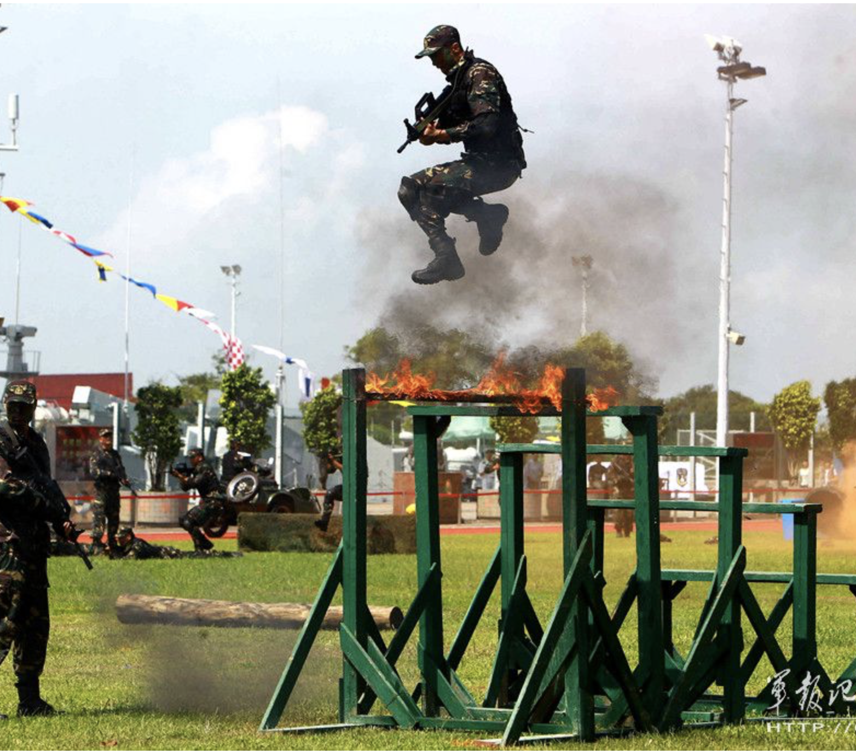
Why God Need to Test Us?
Atheists ask why does God whom you claim to possesses knowledge of the hidden and the manifest within the heavens and the earth, need to examine and test people?
Does there exist something, which is concealed from Him and which may become manifest for Him by means of testing?
The answer lies in the fact that the concept of test with respect to God is vastly different with respect to humans
Human tests are meant for clearing away ambiguity and ignorance, whilst the Divine trials and tribulations are development and training of man’s hidden abilities to bring them from potentiality into actuality, thereby enabling him to progress towards perfection and excellence
Just as iron, for acquiring greater strength, is put into a furnace to make it tempered, similarly human being is also nurtured within the furnace of adversities in order that he or she becomes steadfast
For the purpose of making soldiers tough, militarily, they are made to participate in numerous different exercises and war games, wherein they are subjected to various hardships such as hunger, thirst, heat, chillness, adverse conditions and severe obstacles, in order that they develop into accomplished, conditioned and proficient soldiers
25
Notes:
Type your notes

Slide 26
Thank You
Notes:
Type your notes

