Slide 1
THE SELF-EVIDENT TRUTH
FINDING GOD
THRU REASON
Countering New Atheists’ Narratives
Prepared & Delivered By:
Hafidh Saif Al-Rawahy, 2020
Notes:
Type your notes

Slide 2
IMPORTANT POINTS TO REFLECT UPON FROM PART ONE
Atheism is unnatural, irrational, counter to default state of the mind because its cognitive position is not intuitive, needs to be acquired
Theism, on the other hand, is natural, rational, and represents default state of the mind because its cognitive position is intuitive, does not need to be acquired
Faith in God is “the foundational belief” (universal, untaught, natural, intuitive, and incorrigible); It’s self-evident truth, which requires no proof, and therefore, it’s the human’s default state
Atheists need to answer first, “What reason(s) do they have to reject God’s existence?”; They have not been able to produce valid argument(s) so far
Without God, no one can make sense of the origin of the universe and life; Life would have no meaning, value or purpose; There will be no objective ground to anchor our morals and ethics; And it would not matter how we live our lives
2
Notes:
Type your notes

Slide 3
Global Religious Landscape
The religious profile of the world is rapidly changing, driven primarily by differences in fertility rates, youths, and conversions
Islam will grow faster than any other major religion, and if current trends continue, by 2050 the number of Muslims will nearly equal or outgrow the number of Christians around the world
Atheists and people who do not affiliate with any religion – though increasing in such countries as the US and France, but will make up a declining share of the world’s total population
Buddhism, Judaism and Hinduism will remain the same or increase marginally
Notes:
Type your notes

Slide 4
AGENDA
Finding God Through Reason:
Countering New Atheists’ Narratives
1
2
3
4
5
The Foundational Belief
Islamic Concept of Fitrah
The Existence of God
The Oneness of God
The Attributes of God
Part One
Part Two
Part Three
www.iicoman.om
3
Notes:
Type your notes

Slide 5
The Qur’anic Concept of Fitrah
This concept sheds light upon the Islamic view of man's essential nature in which the one living God is the reality and that He is the only one that is worthy of worship
“So direct your face toward the religion, inclining to truth. [Adhere to] the fitrah of Allah upon which He has created [all] people. No change should there be in the creation of Allah. That is the correct religion, but most of the people do not know” [Qur’an 30:30]
The idea of faith in God as the foundational belief should be acceptable in Western thought; It is also in line with the Qur’anic concept of fitrah, the original human nature or the innate disposition of human being that recognizes the Creator
فَأَقِمْ وَجْهَكَ لِلدِّينِ حَنِيفًا ۚ فِطْرَتَ اللَّـهِ الَّتِي فَطَرَ النَّاسَ عَلَيْهَا ۚ لَا تَبْدِيلَ لِخَلْقِ اللَّـهِ ۚ ذَٰلِكَ الدِّينُ الْقَيِّمُ وَلَـٰكِنَّ أَكْثَرَ النَّاسِ لَا يَعْلَمُونَ
4
Notes:
Type your notes

Slide 6
The Prophet’s Explanation of Fitrah
According to a Hadith from Sahih Bukhari narrated through Abu Huraira (ra), the Prophet (saw) said:
“No child is born except that he is upon innate nature, but his parents make him a Jew or a Christian or Polytheist; as an animal delivers a perfect baby, do you see it disfigured at birth?” [Sahih Bukhari, 1292]
This Hadith is a key quotation in the Prophetic teachings for our understanding of fitrah, which literally means original, and in this context, it would mean the original nature of creation; Human beings are born wired to accept Islam – submission to God
إِمَا مِنْ مَوْلُودٍ إِلَّا يُولَدُ عَلَى الْفِطْرَةِ فَأَبَوَاهُ يُهَوِّدَانِهِ أَوْ يُنَصِّرَانِهِ أَوْ يُمَجِّسَانِهِ كَمَا تُنْتَجُ الْبَهِيمَةُ بَهِيمَةً جَمْعَاءَ هَلْ تُحِسُّونَ فِيهَا مِنْ جَدْعَاءَ ثُمَّ يَقُولُ أَبُو هُرَيْرَةَ رَضِيَ اللَّهُ عَنْهُ فِطْرَةَ اللَّهِ الَّتِي فَطَرَ النَّاسَ عَلَيْهَا
5
Notes:
Type your notes

Slide 7
What is Fitrah?
Fitrah is the natural, original state of human being at birth
Fitrah is a state of intrinsic goodness, pure, sinless, recognizing God deeply in our souls or selves, and longing for Him
The nature of fitrah is such that it does not require external factors to make a person believe in God and act righteously
But it needs external factors to cause a person to deviate or to grow to his or her full potential
If the fitrah of a person is nurtured and well-protected, human being will find belief and virtues appealing to his or her heart, and disbelief and vice abhorrent to him or her
Fitrah as goodness means that the spiritual, intellectual and moral nature of human being is designed in a way that makes it necessary to believe in God, worship Him alone, and act righteously to maintain a well-being, if one chooses to do so
6
Notes:
Type your notes

Slide 8
The First Covenant Between God and Human Beings
”And [mention] when your Lord took from the children of Adam - from their loins - their descendants and made them testify of themselves, [saying to them], "Am I not your Lord?" They said, "Yes, we have testified." [This] - lest you should say on the day of Resurrection, "Indeed, we were of this unaware” [Qur’an 7:172]
وإِذْ أَخَذَ رَبُّكَ مِن بَنِي آدَمَ مِن ظُهُورِهِمْ ذُرِّيَّتَهُمْ وَأَشْهَدَهُمْ عَلَىٰ أَنفُسِهِمْ أَلَسْتُ بِرَبِّكُمْ ۖ قَالُوا بَلَىٰ ۛ شَهِدْنَا ۛ أَن تَقُولُوا يَوْمَ الْقِيَامَةِ إِنَّا كُنَّا عَنْ هَـٰذَا غَافِلِينَ
Allah (SWT) says in the Qur’an that the progeny of Adam had spiritual existence before coming to this material world where they took the first covenant and testified that God is their Lord; Thus, human beings possess primordial awareness of God, which constitutes their nature, prior to their conception
7
Notes:
Type your notes

Slide 9
The Human Consciousness and Freewill
“Truly, We did offer the trust (al-Amanah) to the heavens and the earth, and the mountains, but they declined to bear it and were afraid of it. But the man bore it. Verily, he was unjust (to himself) and ignorant (of its results)” [Qur’an 33:72]
إِنَّا عَرَضْنَا الْأَمَانَةَ عَلَى السَّمَاوَاتِ وَالْأَرْضِ وَالْجِبَالِ فَأَبَيْنَ أَن يَحْمِلْنَهَا وَأَشْفَقْنَ مِنْهَا وَحَمَلَهَا الْإِنسَانُ ۖ إِنَّهُ كَانَ ظَلُومًا جَهُولًا
Human beings’ accepted God’s Trust when all other creatures declined; The Qur’an commentators refer this Trust as the human self-awareness (consciousness) and the freedom of choice (freewill) enabling human beings to develop and grow morally, intellectually and spiritually, and to quest for perfection and excellence
8
Notes:
Type your notes

Slide 10
The Nearness of God to Human’s Soul or Human’s Self
“And We have already created man and know what his soul whispers to him, and We are closer to him than [his] jugular vein” [Qur’an 50:16]
“We are near to it (the soul) than you, but you do not see” [Qur’an 56:85]
وَلَقَدْ خَلَقْنَا الْإِنسَانَ وَنَعْلَمُ مَا تُوَسْوِسُ بِهِ نَفْسُهُ ۖ وَنَحْنُ أَقْرَبُ إِلَيْهِ مِنْ حَبْلِ الْوَرِيدِ
Allah (SWT) asserts in the Qur’an that He is much nearer to us than our own selves; This underlines our recognition of God, our complete dependence on Him and our need to submit to His will; To many, God seems to be far and unreachable, but He reassures us that He is much near to us than our own souls or selves
َنَحْنُ أَقْرَبُ إِلَيْهِ مِنكُمْ وَلَـٰكِن لَّا تُبْصِرُونَ
9
Notes:
Type your notes

Slide 11
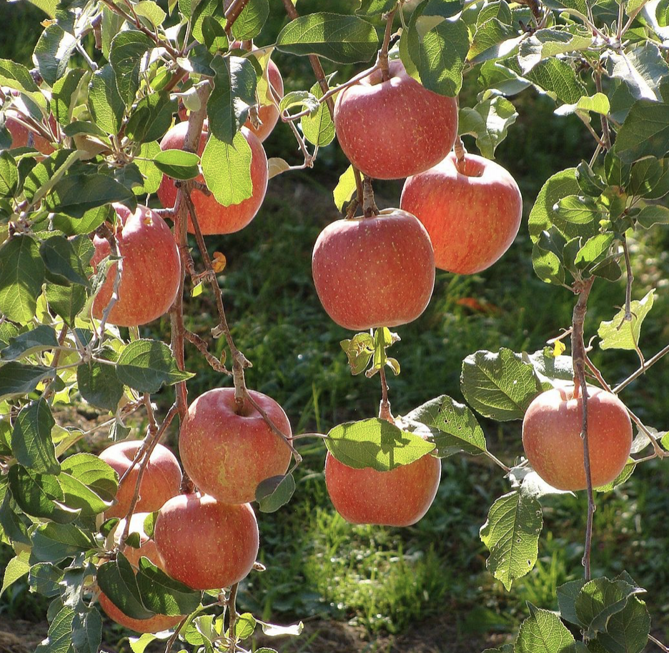
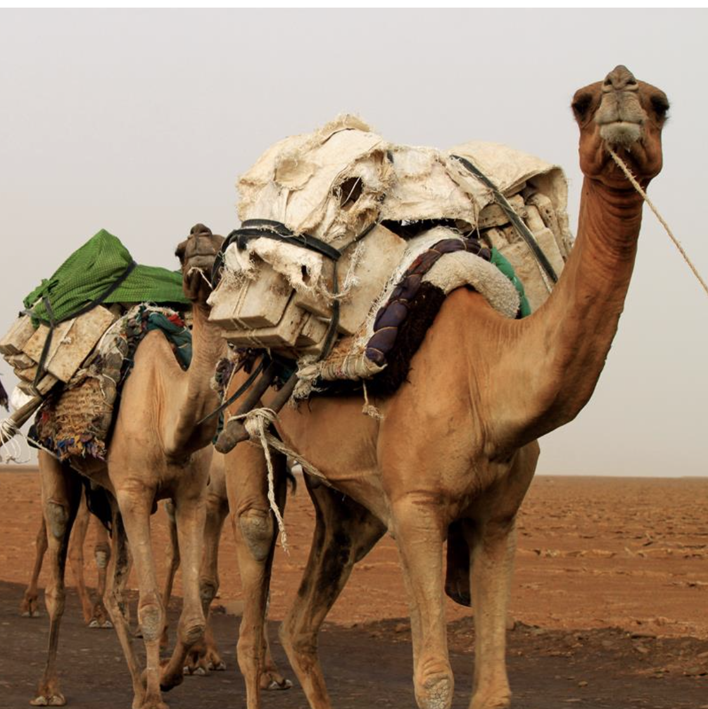
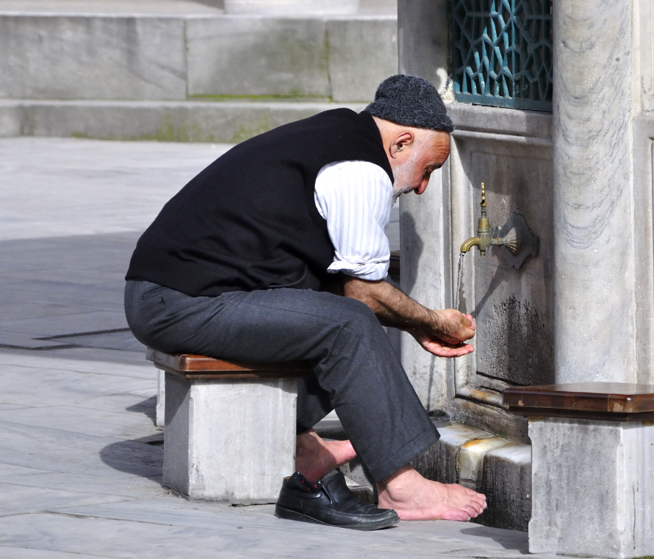
The Power of Reason
In the vegetation domain, the perfection and excellence of plants is to bear specific fruits and the conditions of nature that are available for the development are determined for them as there is no element of consciousness and freewill in the vegetative domain
In animal domain, consciousness and freewill is limited to the level of basic instincts, and the perfection and excellency is their physical abilities to search for food and drink, and to perform physical work
In the human domain, however, in addition to the vegetational and animalistic features; Human beings have been bestowed with extra privileges of consciousness and freewill, such that, they are existentially pursue perfection and excellence through the exercise of their consciousness and freewill, and the faculty of reason
The use of reason is significant in understanding the fundamental reality that is important to all humans: knowing the Creator; If you transit this life and missed all the signposts that are pointing towards the Creator, you have not attained the human perfection and excellence
10
Notes:
Type your notes

Slide 12
The Qur’anic Depiction of Human Nature
Human being is a progeny of Adam and has pre-existed in the spiritual realm before came to this world
Human being is the vicegerent (Khalifa) of God on earth
Human being is given the trust (Amanah)
Human being was taught by God - as such, he possesses the creative intelligence
Human being is created in the best of molds and has been honored
Human being was given the natural disposition (Fitrah)
Human being is placed on the highest pedestal in the hierarchy of creations
The world was prepared for human beings before their coming
Human being has a dual nature of body and spirit, with consciousness, freewill, and power of reason
The Qur’anic depiction of human nature is by far more insightful and more dignified in comparison to atheists’ appalling and depressing image of Darwinian ape squatting in human’s family tree, something diametrically opposed to the Islamic concept of human dignity and the best of God’s creations
11
Notes:
Type your notes

Slide 13
AGENDA
Finding God Through Reason:
Countering New Atheists’ Narratives
1
2
3
4
5
The Foundational Belief
Islamic Concept of Fitrah
The Existence of God
The Oneness of God
The Attributes of God
Part One
Part Two
Part Three
www.iicoman.om
12
Notes:
Type your notes

Slide 14
Cosmological Argument for Existence of the Creator
Existence is divided into three categories:
Necessary Existence (Wajib al-Wujud), which is predicated of that which does not need a cause for its existence
Possible or Contingent Existence (Mumkin al-Wujud), which is predicated of things which can conceivably either exist or not exist, but which must have a cause if they are to exist
Impossible Existence (Mumtani’ al-Wujud), which is predicated of things whose existence would involve a logical contradiction
Because the 3rd category of existence does not have external reality, it will not have relevance in our discussion
Muslim scholars have developed several proofs for God’s existence, His oneness, and His attributes, based on reason; They are simple and require minimum syllogisms; One such proofs, which will be presented here, is the Cosmological Argument, first put forward by al-Farabi (d. 950), later by Ibn Sina (d. 1037) and Imam al-Ghazali (d. 1111)
13
Notes:
Type your notes

Slide 15
The Reality of Existence
If we disregard the impossible existence, existence can either be NECESSARY or POSSIBLE
A possible existent is an effect (Ma’alul), because it always needs a cause (‘Illah)
Since possible existents are known to exist (for example the universe, human beings, animals, plants, etc. they all exist), these objects must have causes that have brought them into existence; If these causes are also possible existents, they in turn must also have causes
Because an endless chain of causes is IMPOSSIBLE, any series of causes and effects must end with a FIRST CAUSE that itself does not have a cause for its existence (no-cause cause)
This FIRST CAUSE, then, must exist necessarily, that is, it must be a NECESSARY EXISTENT (meaning it exists, but without a cause)
It is expected that the first cause could not have similar attributes of things that it had caused to exist
A Demonstration of an Endless Chain of Causes
If each shooter makes a condition not shoot his weapon until his next colleague shoot first, and if this decision prevails among all of the shooters, then none of them will actually shoot i.e. Shooting will not be possible
14
Notes:
Type your notes

Slide 16
The First Cause
In other words, the first cause is necessary to complete the chain of causes for the possible existents to come into being
God is the FIRST CAUSE; He has the Will, the Power, and the Knowledge to bring the possible or contingent objects into being; It is LOGICALLY IMPOSSIBLE that God should not exist, because He the is causal of all that which exists; Without God, nothing will come into existence
Scholars have given other names to the first cause such as the absolute cause or the initial cause or the no-cause cause
God and His creations differ not only in the attributes which they possess, but more fundamentally, in their MODES OF EXISTENCE; God is necessary existent, while creations are possible existents
So far, we have established that every possible existent is an effect that requires a cause; It is not possible to have an endless chain of causes without the first cause, otherwise, we will not be able to explain how all these possible existents came into being – it will contradict the reality; The first cause is a necessary existent
15
Notes:
Type your notes

Slide 17
Dependence of Possible Existent to the Necessary Existent
Whenever you imagine something in your mind, for example, a rose - you will have a mental image of the rose (Surah Dhihniyyah) in your mind
This mental image of the rose in your mind exists because it has been actualized by the will of your soul
The mental image of the rose is an effect (Ma’alul), which can be thought of as a possible existent, and your will is the cause (‘Illah), which can be thought of as a necessary existent (only as an example!)
The cause (your will) is constantly needed for existence of an effect (the imagined rose); i.e. The imagined rose is COMPLETELY DEPENDENT upon your will, at all the time; Any shift of your attention (absence of the cause), the imagined rose will cease to exist
We can illustrate the dependence of possible existent to the necessary existent, through a discovery of an activity of human of imagination, which is used here purely as an example; Note: human will & human soul are not necessary existents
وَهُوَ الَّذِي يَبْدَأُ الْخَلْقَ ثُمَّ يُعِيدُهُ وَهُوَ أَهْوَنُ عَلَيْهِ ۚ وَلَهُ الْمَثَلُ الْأَعْلَىٰ فِي السَّمَاوَاتِ وَالْأَرْضِ ۚوَهُوَ الْعَزِيزُ الْحَكِيمُ
16
Notes:
Type your notes

Slide 18
The Eternity Nature of God (The First & The Last)
For an existent to be non-existing at any interval of time, indicates that the existent is a dependent or need a cause to bring it into existence, and therefore, itself is an effect or a possible existent
Since the necessary existent has always existed and remains in existence by means of itself (by means of its own essence), and it does not require any external existent or cause; It means, the necessary existent could not have been non-existing at any interval of time
Therefore, God was without a beginning (He is the First), meaning that He never had an antecedent of non-existence, and God is without an end (He is the Last), meaning that He will never be non-existent
A possible existent which needs a cause to come to existence and to remain in existence, is an effect (Ma’alul), which comes after the cause (‘Illah); If the cause (‘Illah) is annihilated or was not actualized, then there will be no effect (Ma’alul), and therefore, it will not exist
17
Notes:
Type your notes

Slide 19
The Non-Corporeality Nature of God
The necessary existent must be simple and indivisible (without parts), because of two reasons:
Every composite thing is a synthesis which in need of parts to be complete, while the necessary existent is independent from needs
The necessary existent is not made up of parts because any thing that has parts, intellectually has the potential to be divided, and has the possibility of being annihilated, but the necessary existent cannot be divided or annihilated
Because having parts, potential or actual, is peculiar to corporeality or material nature, therefore, the necessary existent is NON-CORPOREAL and IMMATERIAL
By the same token, the necessary existent is invisible (unseen) i.e. Cannot be sensed through the corporeal senses (seeing, hearing, touching, tasting and smelling)
By disassociating corporeality and materiality from the necessary existent, but present in possible existent, several other possibilities are also nullified; e.g. The necessary existent is not subjected to TIME and SPACE
Space is imagined for a thing, which has a material body and dimensions, and every temporal (time-based) object has the potential of being divided at intervals
Since space and temporality are not attributed to the necessary existent, TRANSITION, GROWTH and MOVEMENT can also be invalidated in necessary existent, because there is no transition, growth, and movement without time and space
Those who misinterpret scriptures by believing that God sits on a throne or descends from heaven or can be seen by the naked eye are viewing Him as being subjected to space, time, growth, movement, and transition, thus, have failed to fully grasp God’s true nature
18
Notes:
Type your notes

Slide 20
How Many First Causes?
The question arises, “How many first causes are there?” Or to put it more generally, “How many necessary existents are there?”
Suppose there is a claim of existence of two (or more) necessary existents
These two beings would be either exactly alike in every respect, or else they would differ from each other
If they were exactly alike in every respect, then there would be no way of distinguishing one of them from the other, and one would have to conclude that they were in fact one and the same being, not two distinct beings
If, however, one of them was distinguished from the other by the possession of an extra attribute that was not possessed by the other, then the one possessing the extra attribute would be compounded of two parts
One part would be that aspect in which it was the same as the other necessarily existent being, and the other part would be that aspect in which it was distinguished from the other necessarily existent
However, if it were compounded of two parts, it could not be necessarily existent, since, as we have seen, anything compounded must have a cause for its composition and anything which has a cause cannot exist necessarily
Thus, only the other necessarily existent being which was not compounded would be necessarily existent
Moreover, if both necessarily existent beings were distinguished from each other by an extra attribute in each, then each would be compounded of two parts and each would need a cause for its composition
Consequently neither one of them would be necessarily existent
19
Notes:
Type your notes

Slide 21
If God Exists, Why Can’t We See Him?
The answer to this false argument is that the perceptions of the senses are due to an outcome of coherence between bodily parts and substances to be perceived
Each one of our senses perceives a particular material form, which is proportional for that sense with defined conditions
In the same way, one cannot expect the eyes to have the sense of sound or the ears to have the sense of sight
Hence, one must not expect our senses to perceive every existent
Our senses are not capable of sensing the reality of the necessary existent who is non-corporeal, non-material, and outside of time and space
One of the common questions asked by the new atheists: “If God exists, why can’t we see Him?”; Atheists make an assumption that the physical universe is all there is, and anyone holding that kind of view finds it hard to grasp the concept of an intangible reality (the unseen world) beyond the physical universe
20
Notes:
Type your notes

Slide 22
Believing in Imperceptible Existent
Among the material existents, there are things, which are not able of being directly perceived through our senses, yet we are not denying their existence
For example, we cannot directly perceive some radio and electro-magnetic waves or microbes (such as the current Covid-19), yet we do not deny; The reason we do not deny them because we can perceive their effects on us
We perceive many realities through other than the means of our outward senses and we confidently believe in their existence; For example, the states of love and fear, happiness and sadness, conscious intentions, etc.; These are psychological stations; Even the perception itself is non-material and imperceptible
Theists do perceive God and experience Him through His attributes of mercy, kindness, peace, loving, forgiveness, etc. Just like the sun, we cannot focus our gaze at it, but we enjoy its attributes of light, warmth and solar energy
All things that we perceive through our senses are manifestations of God’s attributes; They are God’s signs
God can’t be seen by a human eye, because a human eye has limitation - a human eye can only see that it encounters, which has dimensions and occupy space, but as we have said, God doesn’t have corporeal reality, which means He doesn’t have dimensions or occupying any space
In fact, God can’t be sensed by any of the five human sensory organs because on one hand of the limitations of these sensory organs, and on the other hand because of the perfection and infinite qualities of God
21
Notes:
Type your notes

Slide 23
Science Conundrum & God’s Existence
Science focuses its attention on what can be observed; God is outside time and space, therefore, cannot be directly observed; Any method of thinking that relies on observation cannot deny what it cannot observe
Because science has been successful in improving our lives and aids our understanding of the reality of the universe, atheists perceive that science is the only yardstick for truth, and that science has answers for all our questions, and therefore, God is no longer needed, which is an ATHEISTS’ DELUSION
Atheists want to deify science, but science can only explain the reality of physical world by answering the How? questions, it cannot answer the Why? questions
Neither science itself lead to atheism; This fact has been attested by many Western philosophers of science
Muslims have a long history of science; For over a millennium they were building the foundation of science before the Europeans, but they did not produce atheism; On the contrary, many of the classical Muslim scientists were scholars of various Islamic traditions too
Atheists like Richard Dawkins sell to the public the idea that when something is labeled “scientific”, it is a fact and certain
Science tries to explain phenomena in the physical world using scientific models, but these models don’t represent absolute truth, they are based on probabilistic frameworks with assumptions and disputes
Discussions and researches continue within the scientific community on various models, and it is possible to change positions later with new data
Scientific truth is not absolute truth, because it has been inferred from limited observations
New observations can change claimed scientific truth and that is the beauty of science – truth is not set in stone
22
Notes:
Type your notes

Slide 24
Who Created God?
It is important to understand the difference in the MODES of existence between God (the necessary existent) and His creations (the possible existents); God does NOT require a CAUSE, but God’s creations do
Only a POSSIBLE EXISTENT requires a cause (‘Illah), because it is an effect (Ma’alul) or dependent on a cause
But a NECESSARY EXISTENT requires NO cause, because it exist by itself (by its essence); It’s the first cause or the absolute-cause or the no-cause cause
Therefore, the question: “Who created God?” is logically ABSURD question; God has always existed; He has no cause, and thus, has no creator; Neither can we say that God created Himself, because that will be ABSURD too
A common objection we hear from the new atheists: “Who created God?” This objection can be found in Richard Dawkins’ famous book, The God Delusion” His assumption that the mode of existence of the creator is similar to that of the creations, indicates his own delusion in his understanding of the reality of God
23
Notes:
Type your notes

Slide 25
The Qur’anic Argument
Today, many dubious arguments are peddled by the new atheists such as the universe was created by a Big Bang or came from nothing or born out of multiverse
Allah (SWT) provides a powerful logical argument for His existence in the Qur’an addressing the atheists in the form of rhetoric:
“Or were they created by nothing? Or were they the creators [of themselves]? Or did they create the Heavens and Earth? Rather they are not certain.” [Qur’an 52:35-36]
The Qur’an is not saying that the Arabs whom it addressed actually believed that things were created by nothing, or that they created themselves
They certainly did not claim that they were the creators of the Heavens and Earth, and no sane person would make such claim
The Qur’an is only making clear to the atheists, the ABSURDITY of their position of denying God
The Qur’anic rhetoric cites four possibilities to explain how something was created or came into being, BUT ONE ONLY IS CORRECT
Created by nothing – “Or were they created by nothing?”
Self-created – “Or were they the creators [of themselves]?”
Created by something created – “Or did they create the Heavens and Earth?”, which implies a created thing being ultimately created by something else created
Created by something uncreated – “Rather they are not certain”, implying that the denial of God as the Creator is baseless; The Qur’an asserts the existence of uncreated Creator – the First Cause
24
Notes:
Type your notes

Slide 26
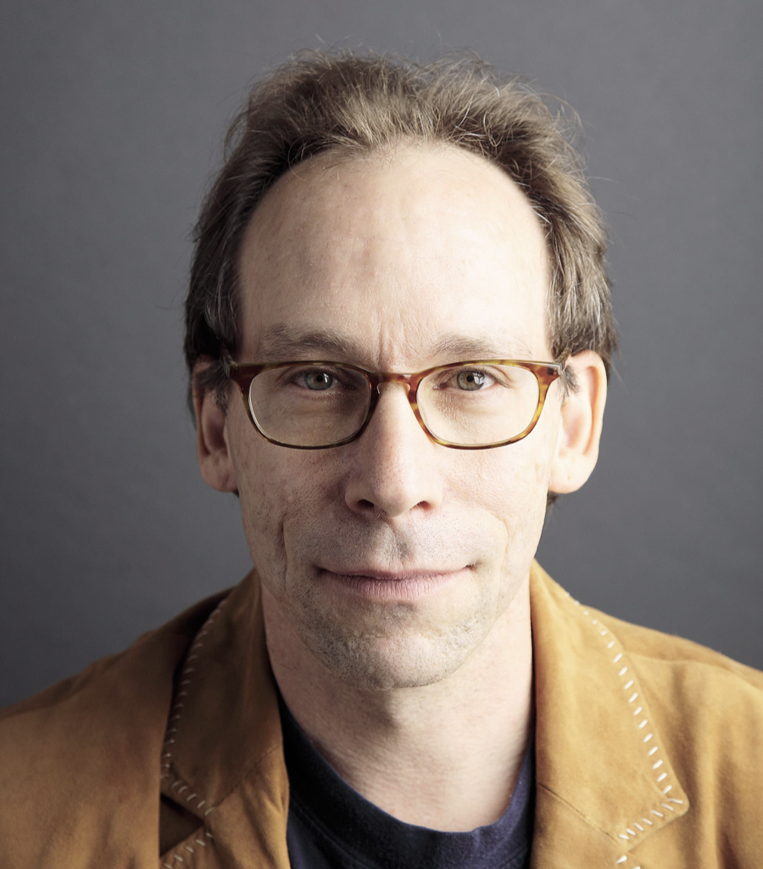
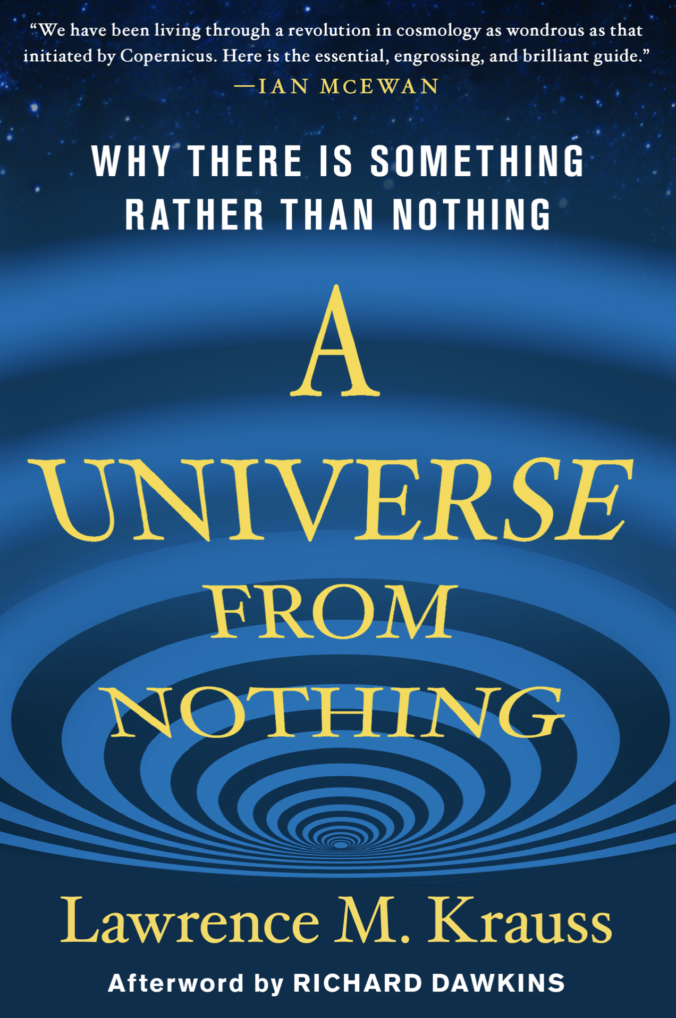
A Universe From Nothing
Lawrence Kraus, a very vocal new atheist has proposed a “universe from nothing” as an argument for non-existence of God in trying to explain about the universe
Asserting that things can come from nothing means that things can come into being from no potential, no matter or no causal, nothing at all; SUCH ASSERTION DEFIES OUR INTUITIONS AND STAND AGAINST REASON
No, the universe could not have come from nothing; Nothingness cannot produce anything, and something cannot arise from no causal conditions whatsoever
Another way of looking at it by simple math: What is 0 + 0 + 0? It is not 3, it’s 0
The reason that the “universe could not have come from nothing” is so intuitive because it is based on a foundational belief or a rational principle: BEING CANNOT COME FROM NON-BEING; To assert the opposite i.e. the universe could come into being without any causal conditions at all is ABSURD
PROFESSOR LAWRENCE M. KRAUSS
25
Notes:
Type your notes

Slide 27
How Did God Create From Nothing?
Lawrence Kraus’s argument of a “universe from nothing” was defeated by theists apologetics, but even by some of his fellow scientists
Some new atheists contended the theists’ view, “If you cannot have something from nothing, how did God create from nothing?”
This contention is FALSE, as it applies that God is NOTHING
God is the unique agent with the potential to create and bring things into existence through His Will, Power and Knowledge
By saying God’s created the universe from nothing, it simply means from no material, but God’s Will, Power and Knowledge were the causal to bring the universe into existence and to sustain its existence
It is irrational to assert that something can emerge from absolute void without any potential or prior causal activity; GOD PROVIDES THAT CAUSAL ACTIVITY
Could Have the Universe Created Itself?
The term “created” means emerged, and therefore, it was once not in existence; By corollary, it is a finite
By understanding the reality of existence, it leads to conclude that self-creation is logically and practically IMPOSSIBILE, because the self-creation implies that something was in existence and not in existence at the same time, which is IMPOSSIBLE
Something that emerged, means it was once not in existence; However, to say it has created itself implies it was in existence before it existed
A good example to drive home this point, “CAN A WOMAN THAT GIVE BIRTH TO HERSELF?” Is it possible?
26
Notes:
Type your notes

Slide 28
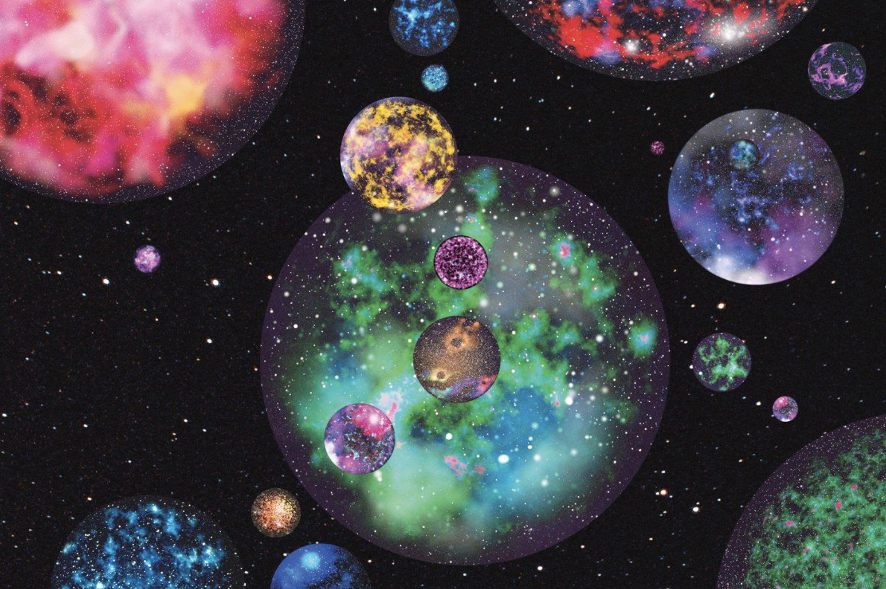
What About Multiverse?
Atheists for a long time were arguing that the universe was eternal, it was not the work of God, when in the Qur’an it is explained that the universe is created (finite)
In 1920s Edwin Hubble observed expansion of the universe that led to discovery of the “Bing Bang” theory; It became scientifically proven that the universe if finite
Atheists found new argument that the universe emerged form the “Bing Bang”, but now is facing the challenge by the “Fine-Tuning” theory that the universe displays a fascinating order where features and laws of nature have been specially designed and fine-tuned to support life on earth, that could not have come randomly by chance
For example, life on earth can occur only if certain fundamental universal physical constants lie within a very narrow range of values; If any of the several of these fundamental universal constants were only slightly different, the earth would be unlikely to support life
It cannot be imagined or expected that this fine-tuning occurred by itself randomly by chance without a designer
The idea of multiverse, if the number of universes was large, the likelihood of having the universe that permits life would be reasonable
Multiverse has not been proven and beyond the reach of observation
Many scholars think it is crazy to postulate a trillion causally-connected universes in order to explain the features of the one universe we know; Just believe in God and will do the job!
27
Notes:
Type your notes

Slide 29
Thank You
Notes:
Type your notes

